Slide 1
Assessment Strategy Overview School of Architecture, Planning & Environmental Policy
Assessment Integrity in the Era of Large Language Models: Threats and Opportunities within the UCD College of Engineering & Architecture
June 2023

Slide 2
100,000
513
116,849
modules offered by the
College of Engineering & Architecture in 2022/23
student credits taught* by the
College of Engineering & Architecture in 2022/23
159
33,028
modules offered by the
School of Architecture, Planning & Environmental Policy
in 2022/23
student credits taught* by the
School of Architecture, Planning & Environmental Policy
in 2022/23
96
Level 4
3
Level 5
School of Architecture, Planning & Environmental Policy
number of modules by level
20
Level 1
19
Level 2
21
Level 3
88
5-credit modules offered within the School
30
10-credit modules offered within the School
40
15+-credit modules offered within the School
344
different assessed components within modules offered by the School of Architecture, Planning & Environmental Policy
in 2022/23
BSc Architectural Science
flagship course offered by the
School of Architecture, Planning & Environmental Policy
Portfolio
most common assessment type used within modules
offered by the School of Architecture, Planning & Environmental Policy
in 2022/23
Practical Examination
least common assessment type used within modules
offered by the School of Architecture, Planning & Environmental Policy
in 2022/23
*Student Credits Taught = Module ECTS Credits × 2022/23 Enrolled Students

Slide 3
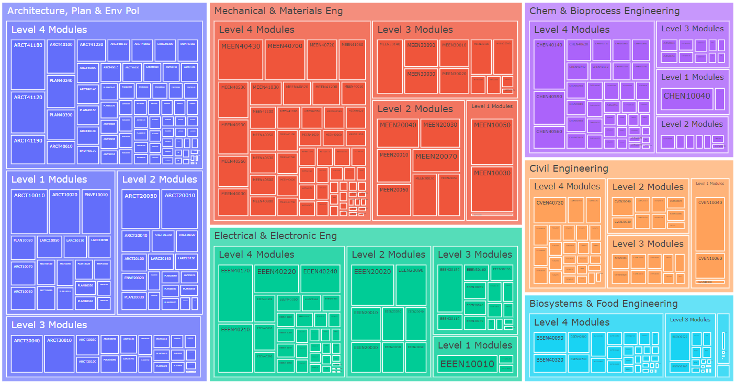
College of Engineering & Architecture – Modules by School
2022/23 Academic Year – Modules Weighted by Student Credits

Slide 4
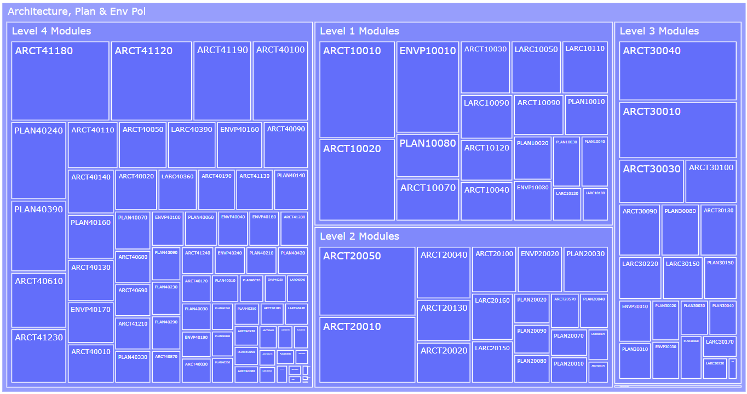
School of Architecture, Planning & Environmental Policy Modules
2022/23 Academic Year – Modules Weighted by Student Credits

Slide 5
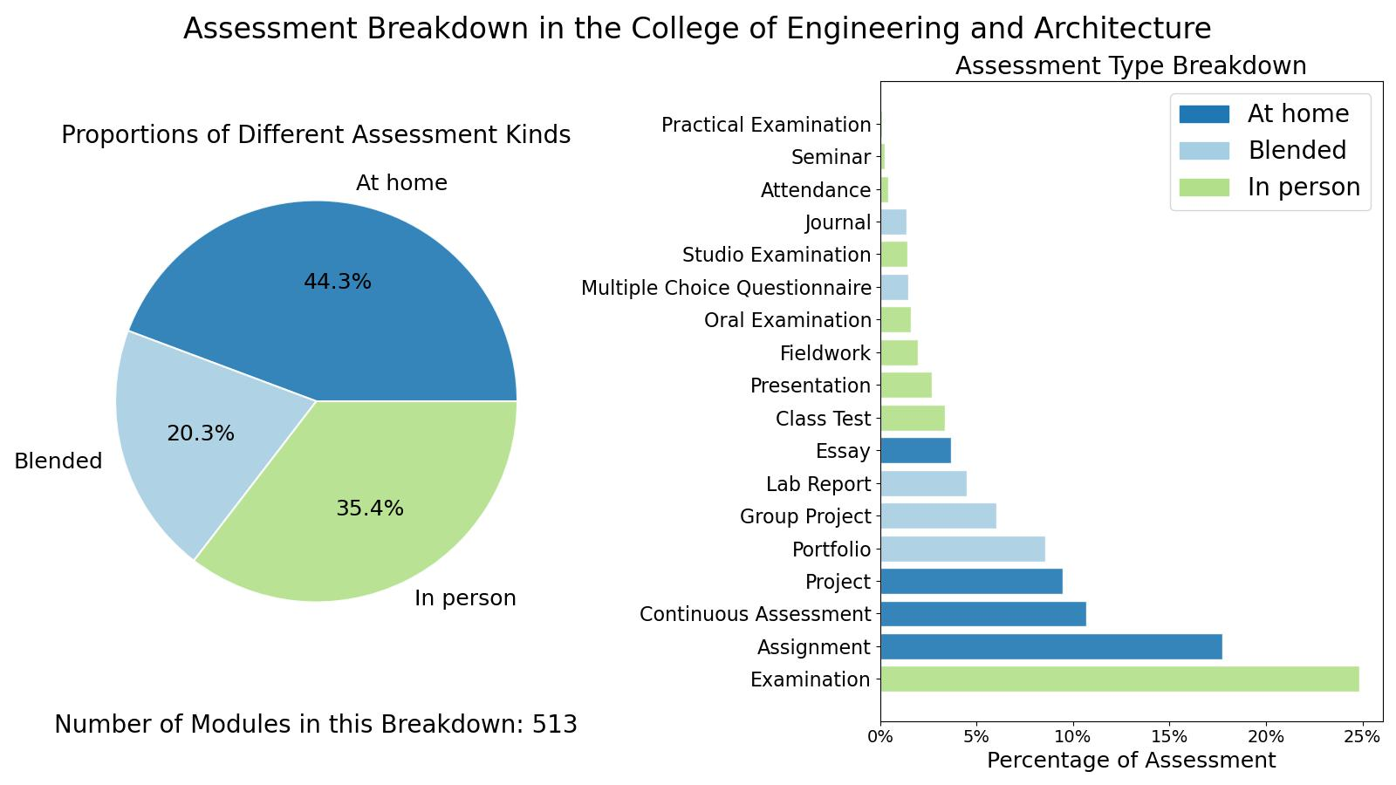
College of Engineering & Architecture

Slide 6
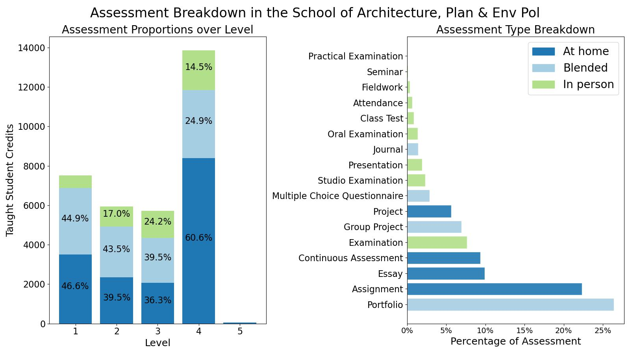
School of Architecture, Planning & Environmental Policy

Slide 7
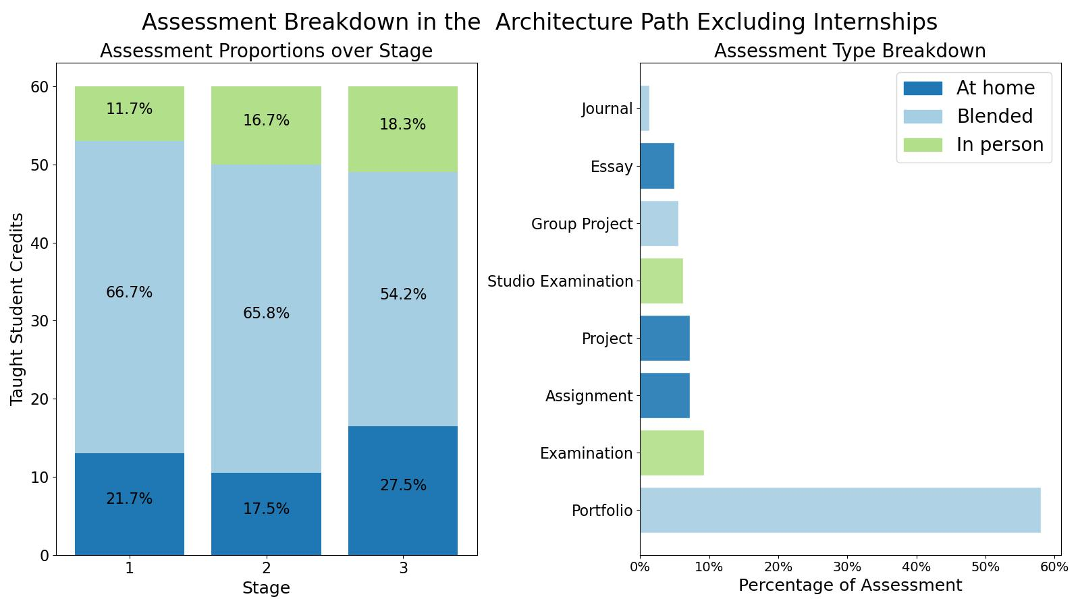
BSc Architectural Science

Slide 8
Assessment Strategy Overview School of Architecture, Planning & Environmental Policy Assessment Integrity in the Era of Large Language Models: Threats and Opportunities within the UCD College of Engineering & Architecture June 2023

